Slide 1



JAVA
FOR
ANDROID

Slide 2

Guy who holds the Logic
Java is a language which is used at a major scale for the development of mobile applications
Java plays an important role in development of Android applications because business logic is written in Java.

Slide 3
Advantages of Java
Object Oriented − In Java, everything is an Object. Java can be easily extended since it is based on the Object model.
Platform Independent − Write Once Run Anywhere
Simple − Java is designed to be easy to learnSecure − With Java's secure feature it enables to develop virus-free, tamper-free systems. Authentication techniques are based on public-key encryption.
Robust − Java makes an effort to eliminate error prone situations by emphasizing mainly on compile time error checking and runtime checking.
Multi-threaded - Java is designed to do Multiple Simultaneous Tasks
And a Lot More

Slide 4
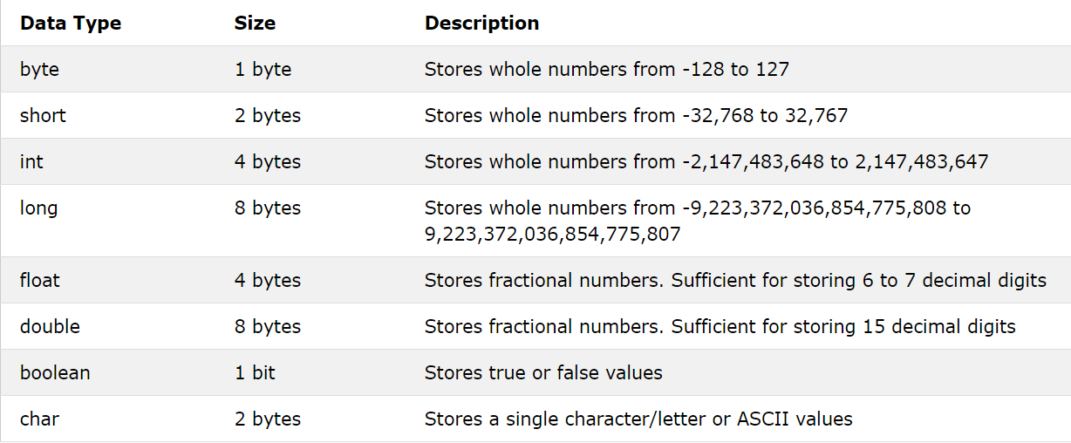
Primitive Data Types

Slide 5
Operators
Java Operators
https://www.w3schools.com/java/java_operators.asp

Slide 6
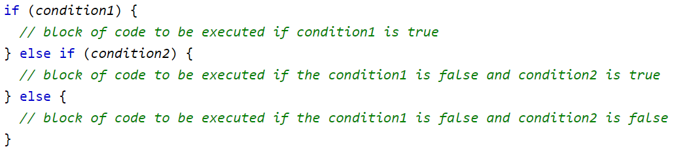
Decision Making
If - Else If

Slide 7
Loop Control
Arrays
Functions / Methods
. . . . .

Slide 8
Object Oriented Programming (OOP)
Object-oriented programming (OOP) is a programming language model in which programs are organized around data, or objects, rather than functions and logic.
Features Of OOP
Encapsulation
Abstraction
Inheritance
Polymorphism

Slide 9
Objects / Classes
Classes and objects are the fundamental components of OOP's.
What is an Object?
An object is nothing but a self-contained component which consists of methods and properties to make a particular type of data useful. Object determines the behavior of the class.
What is Class?
A class is an entity that determines how an object will behave and what the object will contain. In other words, it is a blueprint or a set of instruction to build a specific type of object.

Slide 10
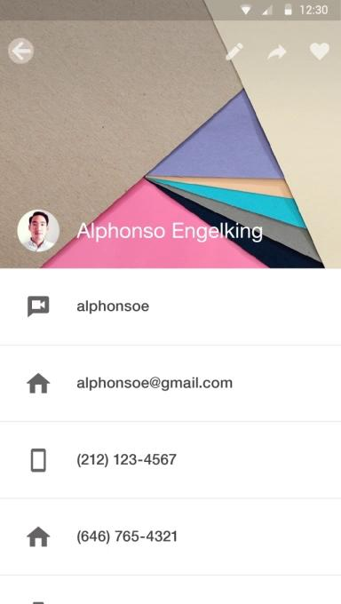
Activity
An activity represents a single screen with a user interface just like window or frame of Java.
Activity is nothing but a java class in Android which has some pre-defined functions which are triggered at different App states, which we can override to perform anything we want.
Activity LifeCycle

